Slide 1
Porter’s Value Chain analysis

Slide 2
Introduction
categorizes an organization's business processes into groups based on how the processes create value.
This model divides the business's operations into distinct elements and allows business leaders to build a value chain, or a set of activities that creates more value than they cost.
Porter's value chain distinguishes between primary activities, which directly generate revenue, and support activities, which make the primary activities possible.
Elements of Porter’s value chain consists of primary and support activities

Slide 3
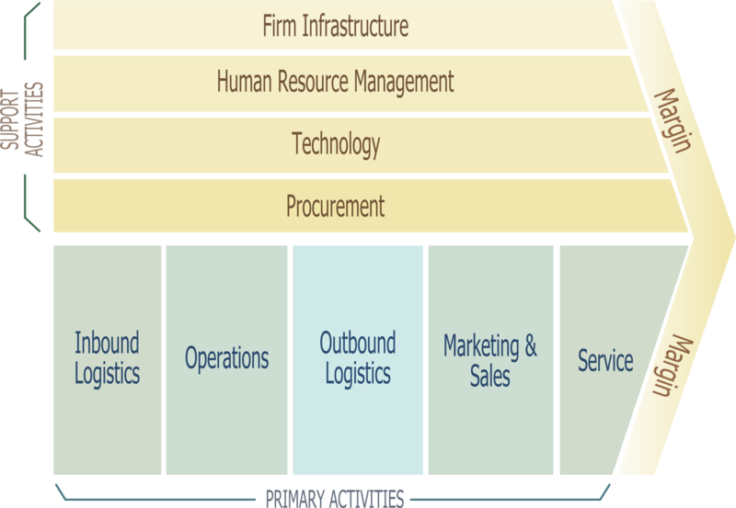

Slide 4
Primary activities
The sequence of activities through which raw materials are transformed into benefits enjoyed by the customer is called primary activities.
These activities relate directly to the actual creation, development, manufacture, distribution, sales and servicing of the product or the service to a customer.
Five major activities are involved in this sequence: inbound logistics, operations, outbound logistics, marketing and sales and service.

Slide 5
Inbound Logistics: As the word implies, inbound logistics deal with the handling of raw materials and inventory received from the firm’s suppliers. Detail activities include Receiving, storing, materials handling, warehousing, inventory control, vehicles scheduling and returns to suppliers.
Operations: Operations are the activities and procedures that transform raw materials, components and other inputs into finished end products. Detail activities include machining, packaging, assembly, equipment maintenance, testing, printing, facility operations.
Outbound Logistics: Outbound logistics refers to the transfer of finished product to the distribution channel members. The focus of outbound logistics is on managing the flow and distribution of products to the firm’s immediate customers such as wholesalers and retailers. Activities and procedures associated with outbound logistics include inventory control, warehousing, order processing, delivery schedule maintenance etc.

Slide 6
Marketing and Sales: Marketing and sales include advertising, promotion, product mix pricing, specifying distribution channel members, maintaining channel relations etc in order to induce and facilitate buyers to purchase the product.
Service: Customer service is a central value adding activity that a firm can seek to improve over time. It includes installation, repair, training, parts supply and product adjustment in order to maintain or enhance the value of the product after sales.
Secondary/ Support activities
The remaining activities of the value chain are undertaken to support primary activities.
Support activities help the firm improve co-ordinations across and achieve efficiency within the firm’s primary value adding activities.
This includes, procurement, technology development, human resource management and firm level infrastructure.

Slide 7
Procurement: Securing inputs (such as raw materials, supplies, and other consumable items and assets) for primary activities.
Technology Development: Methods of performing primary activities are improved (Such as know-how, procedures, technological inputs needed)
Human Resource Management: Employees who will carry out the primary activities are recruited, trained, motivated and supervised.
Firm Infrastructure: Activities such as accounting, finance, legal affairs, and regulatory compliance are carried out to provide ancillary support for primary activities.

Slide 8
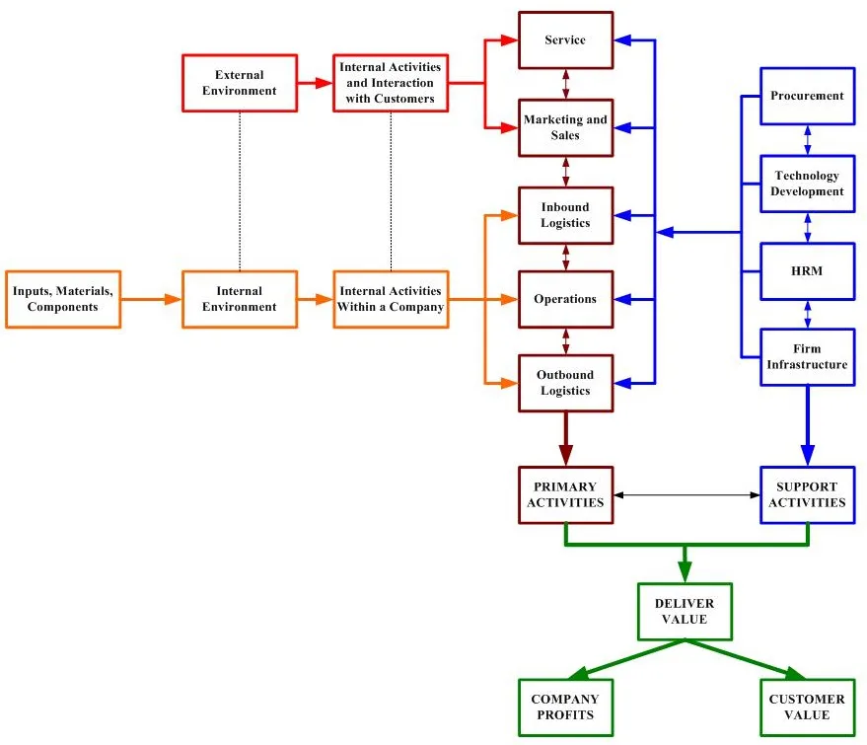
Linkage between Primary & Secondary activities

Slide 9
The starting point is the purchase of inputs, raw materials and components.
Those are delivered into a company’s internal environment.
Activities such as inbound logistics facilitate the processes where all the inputs are stored and distributed internally.
Operations in turn are responsible to develop an output where it will be delivered to the customer by various activities carried out by the outbound logistics.
The remaining primary activities, Sales, Marketing, and Service consist of numerous activities that facilitate interaction with the external environment which is the customers (on the hand to convince them to purchase the product and on the other hand, to support them in using it).
Support Activities interact with the primary ones with purpose to deliver value for the organization but as well as for the end user.

Slide 10
Benefits
Clarity: Using the value chain can help business leaders and managers understand how different activities affect each other.
Strategic Planning: Dividing a business model into a set of discrete activities can help managers and directors create strategic plans to boost value in specific stages.
Competitive edge: Improving the individual stages in a company's business activities can help leadership teams build a brand that's distinct from competitors in the market.

Slide 11
How to use Porter’s Value Chain
Find the sub-activities that relate to each primary activity
Direct activities: These sub-activities directly result in revenue.
Indirect activities: These sub-activities indirectly create revenue by supporting the direct activities.
Quality assurance activities: These activities ensure the organization's goods or services are of a certain quality standard.
Find the sub-activities that relate to each support activity
Find connection between activities
Optimize individual activities and monitor the effects

